Slide 1
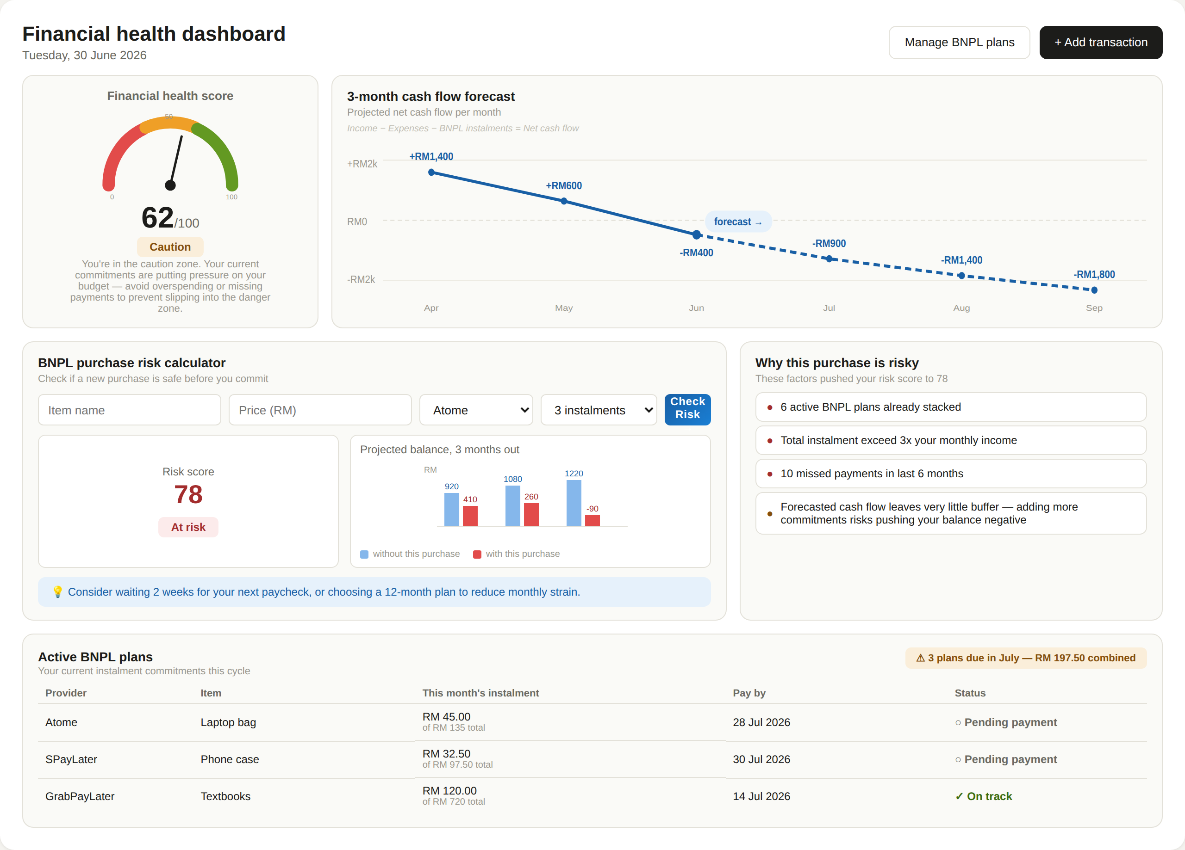





PaySense — Web Dashboard
WEB APP PROTOTYPE
Interactive financial health dashboard prototype
Key Features
Financial Health Score
0–100 gauge showing overall money-health status
3-Month Cash Flow Forecast
ARIMA-based projection of upcoming net balance
BNPL Risk Calculator
XGBoost risk score before committing to a new purchase
Explainable AI (SHAP)
Plain-language reasons behind every risk flag
Active BNPL Tracker
Live view of instalments, due dates and status

